Slide 1
Scaling Your DynamoDB Application: Autoscaling, Global Tables, and DAX
Section 4

Slide 2
The Unit of Performance in DynamoDB: Provisioned Capacity Units

Slide 3
Let Us Briefly Re-Visit What DynamoDB Is
A fully managed NoSQL database

Slide 4
Let Us Briefly Re-Visit What DynamoDB Is
A fully managed NoSQL database
The closest thing we can get to database, as a service

Slide 5
Let Us Briefly Re-Visit What DynamoDB Is
A fully managed NoSQL database
The closest thing we can get to database, as a service
We never have to think about servers, operating systems or networking, we just configure the service and consume it via API

Slide 6
Let Us Briefly Re-Visit What DynamoDB Is
A fully managed NoSQL database
The closest thing we can get to database, as a service
We never have to think about servers, operating systems or networking, we just configure the service and consume it via API
Under the hood, Amazon needs to be able to manage capacity for each users table, and correspondingly bill for usage of that table

Slide 7
DynamoDB – Scaling Fundamentals
Read capacity units: The amount of read capacity you provision against your table, also applies to indexes

Slide 8
DynamoDB – Scaling Fundamentals
Read capacity units: The amount of read capacity you provision against your table, also applies to indexes
Write capacity unit: The amount of write capacity you provision against your table, again also applies to indexes

Slide 9
DynamoDB – Scaling Fundamentals
Read capacity units: The amount of read capacity you provision against your table, also applies to indexes
Write capacity unit: The amount of write capacity you provision against your table, again also applies to indexes
Storage: Scales transparently, but the maximum storage for a single partition is 10GB

Slide 10
Read Capacity Units
If you decide to provision capacity yourself, you must choose how many units you want to allocate to a table

Slide 11
Read Capacity Units
If you decide to provision capacity yourself, you must choose how many units you want to allocate to a table
One Read Capacity Unit (RCU) represents one strongly consistent read, or two eventually consistent reads for an item up to 4KB in size

Slide 12
Read Capacity Units
If you decide to provision capacity yourself, you must choose how many units you want to allocate to a table
One Read Capacity Unit (RCU) represents one strongly consistent read, or two eventually consistent reads for an item up to 4KB in size
If the item is larger than 4KB, additional capacity units are consumed

Slide 13
Read Capacity Units
If you decide to provision capacity yourself, you must choose how many units you want to allocate to a table
One Read Capacity Unit (RCU) represents one strongly consistent read, or two eventually consistent reads for an item up to 4KB in size
If the item is larger than 4KB, additional capacity units are consumed
Transactional reads consume two RCUs, for items up to 4KB

Slide 14
Read Capacity Units
If you decide to provision capacity yourself, you must choose how many units you want to allocate to a table
One Read Capacity Unit (RCU) represents one strongly consistent read, or two eventually consistent reads for an item up to 4KB in size
If the item is larger than 4KB, additional capacity units are consumed
Transactional reads consume two RCUs, for items up to 4KB
RCUs refill every second, so 1 RCU gives you one strongly consistent
read per second

Slide 15
Write Capacity Units
One Write Capacity Unit (WCU) represents one write, for an item up to 1KB in size

Slide 16
Write Capacity Units
One Write Capacity Unit (WCU) represents one write, for an item up to 1KB in size
If the item is larger than 1KB, additional write capacity units are consumed

Slide 17
Write Capacity Units
One Write Capacity Unit (WCU) represents one write, for an item up to 1KB in size
If the item is larger than 1KB, additional write capacity units are consumed
Transactional writes consume two WCUs, for items up to 1KB

Slide 18
Write Capacity Units
One Write Capacity Unit (WCU) represents one write, for an item up to 1KB in size
If the item is larger than 1KB, additional write capacity units are consumed
Transactional writes consume two WCUs, for items up to 1KB
RCU’s refill every second, so 1 RCU gives you one strongly consistent read
per second

Slide 19
Write Capacity Units
One Write Capacity Unit (WCU) represents one write, for an item up to 1KB in size
If the item is larger than 1KB, additional write capacity units are consumed
Transactional writes consume two WCUs, for items up to 1KB
RCU’s refill every second, so 1 RCU gives you one strongly consistent read
per second
The maximum allowable item size is 400KB: Writing one item of this size per second would require 400 WCU’s

Slide 20
Bursting
DynamoDB also allows you to temporarily burst beyond your provisioned capacity

Slide 21
Bursting
DynamoDB also allows you to temporarily burst beyond your provisioned capacity
Dynamo works by retaining up to five minutes of unused capacity units, for you to use

Slide 22
Bursting
DynamoDB also allows you to temporarily burst beyond your provisioned capacity
Dynamo works by retaining up to five minutes of unused capacity units, for you to use
For example, if you have a table configured with 1 RCU and the table remains idle for a five minute period, at the end of this period, you will have accumulated 300 RCUs, which are available in a rolling window for burst capacity

Slide 23
Partition Limits
Remember that DynamoDB is a distributed system, and your provisioned capacity is distributed across all partitions in a given table

Slide 24
Partition Limits
Remember that DynamoDB is a distributed system, and your provisioned capacity is distributed across all partitions in a given table
Let us say, you have provisioned a table with 400 RCUs and 400 WCUs, and that table has 4 partitions

Slide 25
Partition Limits
Remember that DynamoDB is a distributed system, and your provisioned capacity is distributed across all partitions in a given table
Let us say, you have provisioned a table with 400 RCUs and 400 WCUs, and that table has 4 partitions
Each partition will be allocated 100 RCUs and 100 WCUs

Slide 26
Partition Limits
Remember that DynamoDB is a distributed system, and your provisioned capacity is distributed across all partitions in a given table
Let us say, you have provisioned a table with 400 RCUs and 400 WCUs, and that table has 4 partitions
Each partition will be allocated 100 RCUs and 100 WCUs
If more than 100 RCUs or 100 WCUs are consumed on a given partition, it will start to get throttled

Slide 27
Partition Limits
Remember that DynamoDB is a distributed system, and your provisioned capacity is distributed across all partitions in a given table
Let us say, you have provisioned a table with 400 RCUs and 400 WCUs, and that table has 4 partitions
Each partition will be allocated 100 RCUs and 100 WCUs
If more than 100 RCUs or 100 WCUs are consumed on a given partition, it will start to get throttled
This is called a “hot partition” scenario, where read/write load is unevenly distributed

Slide 28
Adaptive Capacity
Dynamo attempts to alleviate this issue, by dynamically reallocating provisioned capacity to hot partitions

Slide 29
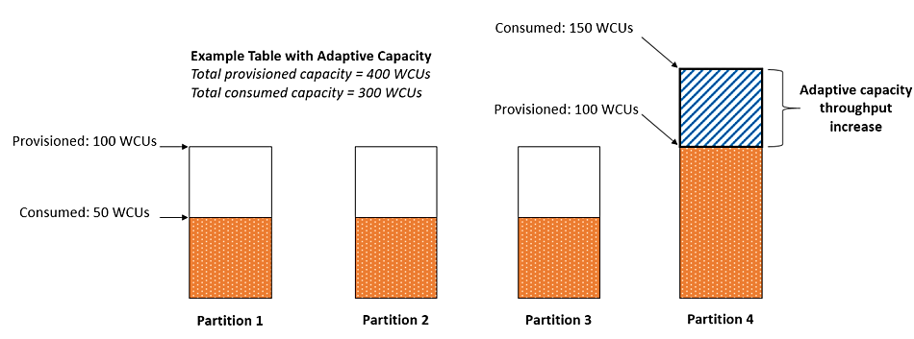
Adaptive Capacity
Dynamo attempts to alleviate this issue, by dynamically reallocating provisioned capacity to hot partitions

Slide 30
Pricing
The last piece of the puzzle is the pricing model you pay, for provisioned RCUs, WCUs, and consumed storage; these prices are for EU-West-1 (Ireland)

Slide 31
Pricing
The last piece of the puzzle is the pricing model you pay, for provisioned RCUs, WCUs, and consumed storage; these prices are for EU-West-1 (Ireland)
$0.000147 per RCU/ hour: $0.10/month

Slide 32
Pricing
The last piece of the puzzle is the pricing model you pay, for provisioned RCUs, WCUs, and consumed storage; these prices are for EU-West-1 (Ireland)
$0.000147 per RCU/ hour: $0.10/month
$0.000735 per WCU/hour: $0.53/month

Slide 33
Pricing
The last piece of the puzzle is the pricing model you pay, for provisioned RCUs, WCUs, and consumed storage; these prices are for EU-West-1 (Ireland)
$0.000147 per RCU/ hour: $0.10/month
$0.000735 per WCU/hour: $0.53/month
$0.283 per GB per month. First 25GB is free!

Slide 34
Automatically Responding to the Demand with Autoscaling
Next Video

